Slide 1
Automatic Door Monitoring and Smart Lighting System using WOT
Keshav Sharma (15BCE1341)
Neeraj Kumar (15BCE1129)
Ayush Sharma (15BCE1126)

Slide 2
ABSTRACT
The most important considerations in current technologies are automation, energy consumption and profitability. Automation aims to reduce the workforce through the use of intelligent systems. The project aims to describe a method of controlling lights and appliances with infrared sensors with minimal electrical energy consumption. When presence is detected, the streetlights are lit or off. Whenever a person crosses particular area, the lights on and off depend on the distance that is recorded by the infrared sensor.
This project has an automatic door monitoring system that uses Raspberry Pi to recognize the face with the camera. If the authorized person has come, the door is unlocked, otherwise it is locked. However, the current security system has many weaknesses, where it is simply expressed. Most doors are controlled by persons with keys, security cards, counter-signs or models for opening doors.

Slide 3
Problem Statement
It’s very difficult for old and handicapped people to live independently. This project will help elderly or handicapped people to live a better independent life as long as possible. Existing system and proposed system have same costing all the way but making extensive use of it by bridging two microprocessors over WIFI module and running the system synchronously is a complete automated system and this is the main objective of the project. System has been trained under various situation likely to come for everyone and automating it accordingly for the best working.

Slide 4
Project Description
The system works with 3.3 and 5 V DC. The components connected to the Raspberry PI 3 are an infrared sensor and an IC ULN2803APG relay driver. The project consists of two components: a door monitoring system with Raspberry Pi and 5V with a small transformer; the other smart lighting system running on a NodeMCU connected to the 3.3V transformer.
When a person stands in front of camera, it recognizes the image after being compared with the images stored in the database when it is validated, the door motor turns, however, when a strangely comes, system sends an image to the E -Mail. Once the image has been authenticated by the user who has the application in his smartphone, can then send that person via smartphone.

Slide 5
Goals
Making a user-friendly home automation system for old aged and disabled people.
Reducing the energy consumption rate having a remote access over all appliances of the house.
Alert the house owners of approaching unknown persons.
Safety from any kind of stealth action and spying activities.
To interface the two different microcontrollers on a common platform interconnected with each other.
Automatic motion-based lighting that can also be controlled with app.

Slide 6
Hardware SpecificationS NodeMCU ESP8266:
The ESP8266 is a low-cost WiFi module chip that can be connected to the Internet for the Internet of Things (IoT). They do not have the built-in configuration to do this. You can install the ESP8266 with this device and do incredible things. Control, monitoring, analysis and much more.

Slide 7
Raspberry Pi Quad Core Cortex A53
The Raspberry Pi 3 Model B is a computer the size of a credit card. Just add a keyboard, a mouse, a monitor, a power adapter and a microSD card with Linux distribution installed, and you have a full-fledged computer that can run applications ranging from word processor software and spreadsheets to applications.
Since the Raspberry Pi 3 supports HD video, it can even create a Media Center. The Raspberry Pi 3 Model B is the first Raspberry Pi to be open source from the start and should be the de facto embedded Linux card in all forums.

Slide 8
Raspberry PI 5MP Camera Board Module
The Raspberry Pi Camera v2 is the new official camera card released by the Raspberry Pi Foundation, a high quality 8 megapixel Sony IMX219 expansion card for the Raspberry Pi, designed specifically for the image sensor. One of the small sockets is located on the top of the card and uses the dedicated Csi interface, which was specially developed for connection to the cameras

Slide 9
DC Motor:
A DC motor is part of a class of rotary electric machines that convert DC electrical energy into mechanical energy. The most common types are based on the forces generated by magnetic fields. Nearly all types of DC motors have an internal mechanism (electromechanical or electronic) to periodically change the current direction in a part of the motor.

Slide 10
Two-Channel Relay Switch:
The Arduino Relay Module enables a variety of microcontrollers such as Arduino, AVR, PIC, ARM with digital outputs to control larger loads, and devices such as AC or DC motors, solenoids, solenoids, and incandescent bulbs. This module can be integrated with 2 relays that can control 2 relays. The relay shield uses a high quality QIANJI JQC-3F relay rated at 7A / 240V AC, 10A / 125V AC and 10A / 28V DC. The relay output is indicated individually by a light emitting diode. Figure 15: ESC 4 x 30 amps.

Slide 11
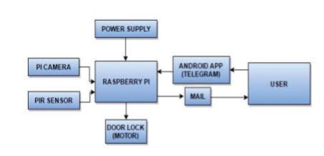
Block diagram of Door Monitoring System

Slide 12
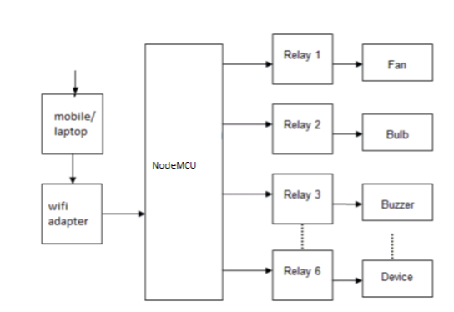
Block diagram of Smart Lighting system

Slide 13
Internet of Things (IOT):
Advantages of implementation:
1. Effective use of resources
2. Reduction of human effort
3. Reduces costs and increases productivity
4. Real-time marketing
5. Decision analysis
6. Best customer experience
7. High quality data

Slide 14
Image Processing
Image processing is a method of converting an image into a digital format and performing certain operations to obtain an enhanced image or to extract useful information therefrom. This is a type of signal distribution in which the input is an image, such as a video image or a photograph, and the output can be an image or features associated with that image. Typically, the image processing system is to process the images as two-dimensional signals while applying already defined signal processing techniques.

Slide 15
The image processing is divided into 5 groups:
1. Visualization - Observe invisible objects.
2. Sharpen and restore images - create a better image.
3. Image Recovery - Look for the image that interests
4. Pattern Measurement - Measures different objects in a picture.
5. Image Recognition - Distinguish objects in an image.

Slide 16
Web of Things
Connecting every object to the Internet and assigning it an IP address is only the first step towards the Internet of Things. Things could easily exchange data with each other, but they do not necessarily understand what that data means. This is what Web protocols such as HTTP bring to the Internet: a universal way of describing images, text, and other multimedia so that machines can "understand" each. The Web of Things - or WoT - is just the next step in this evolution: using and customizing web logs to connect everything that exists in the physical world and make it available on the World Wide Web.

Slide 17
Module Description
The project comprises of two modules in the project one is door monitoring on RPI and smart lighting system over NodeMCU but the curious thing here is both have a common platform to access the things connected with them. DC motor is communicating with both RPI after processing the image and NodeMCU through the android application. Similarly, more appliances can be controlled using the multiple channel relay switch. Both the microcontrollers have been powered using a 5v transformer to reduce the delay in processing. Based on the pins of microcontroller connected appliances can be controlled form anywhere around the world if both user’s device and both the microcontrollers are connected over the internet.

Slide 18
CONCLUSION
In the current scenario people are focusing in making their home smart. Already ample of research exists on the same topic as given in references. Smart lighting is mostly implemented on Arduino whereas NodeMCU is more efficient and effective way of doing the same thing have used relays and transformers to give optimum supply of voltage to each appliance. As door monitoring system has been designed in a bit different way taking multiple real-life test cases.

Slide 19
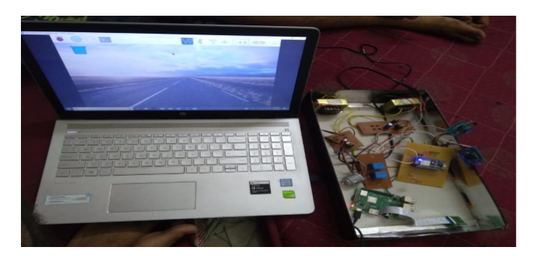

Slide 20
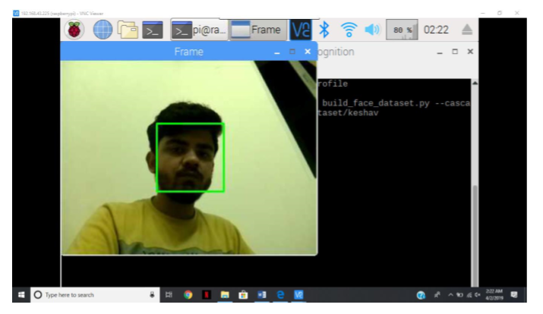

Slide 21
